Slide 1

Topic Modeling for
News Articles

Slide 2

Introduction

Slide 3
Business Objective

Slide 4
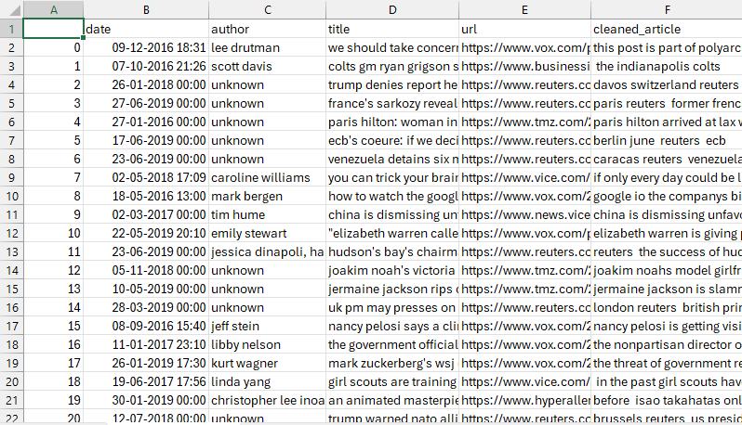
Dataset:

Slide 5
Data Preprocessing

Slide 6
TF-idf Vectorization
TF – Helps find the most frequently appearing words in the document
Idf – reduces the common words and highlights the words that are
unique to a few documents

Slide 7
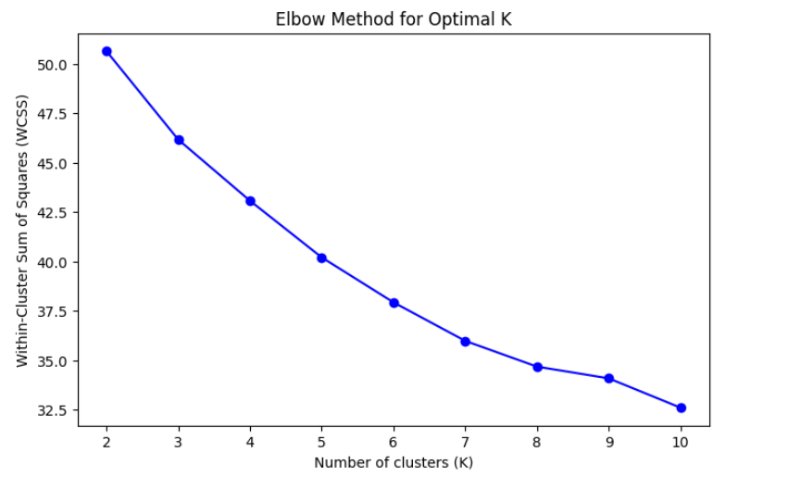
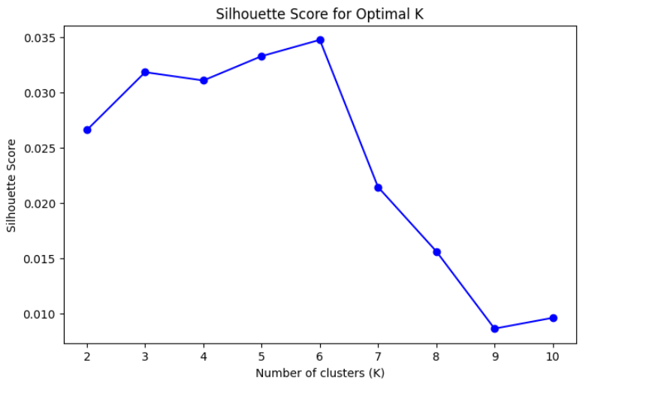
Optimal K value
Elbow Method
Silhouette Score

Slide 8
PCA for Dimensionality Reduction

Slide 9
K-Means
Clustering Using Cosine Similarity

Slide 10
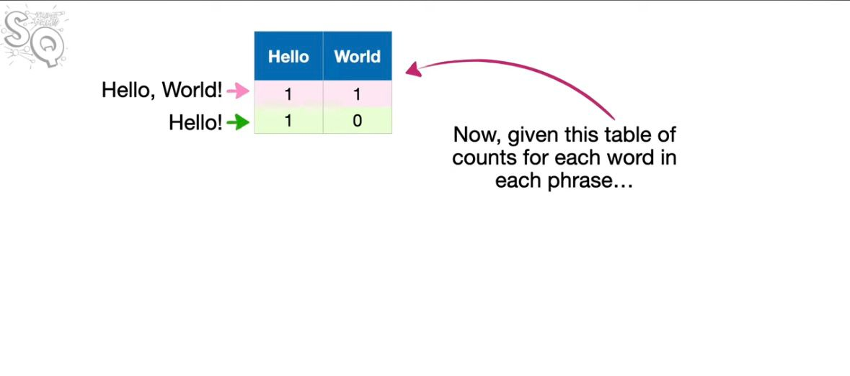

Slide 11
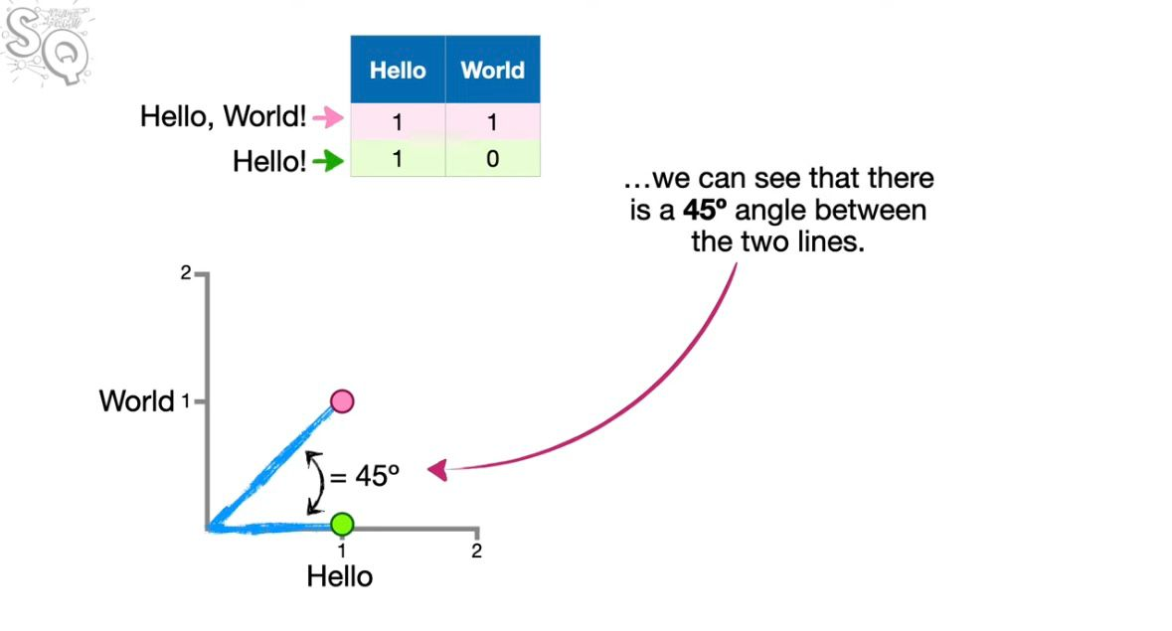

Slide 12
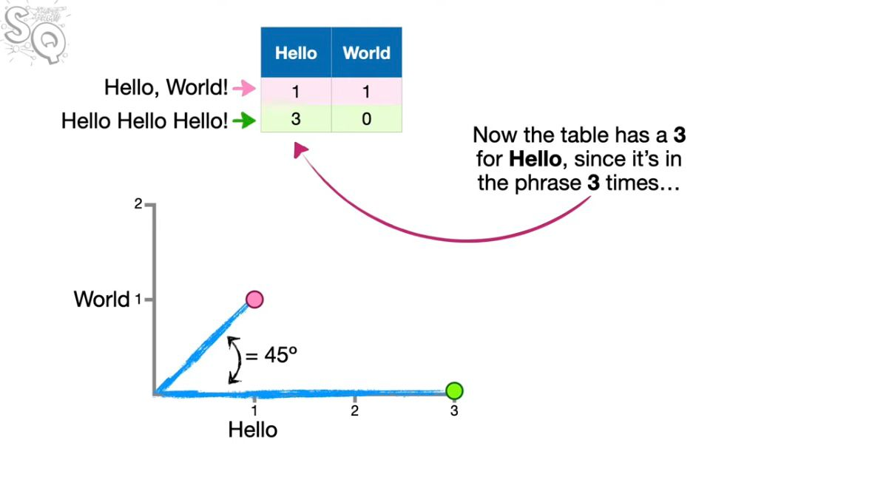

Slide 13
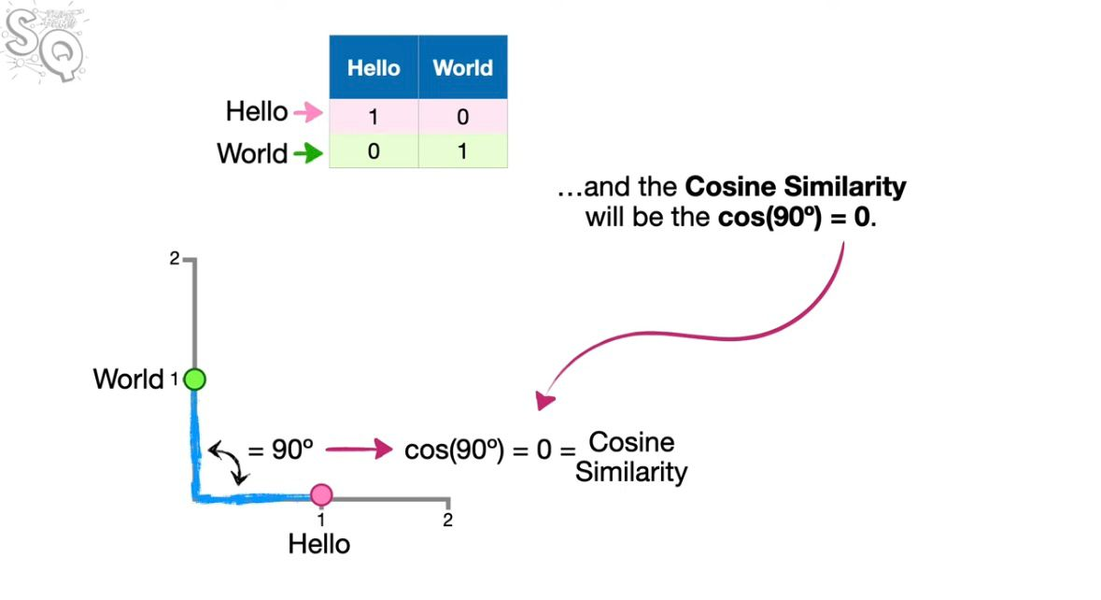

Slide 14
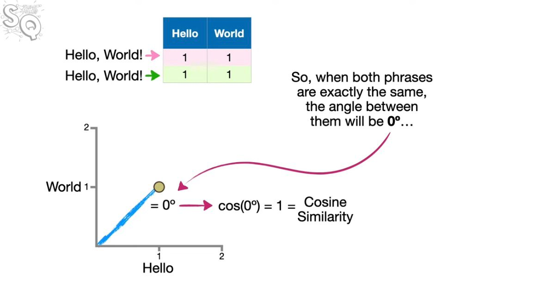

Slide 15

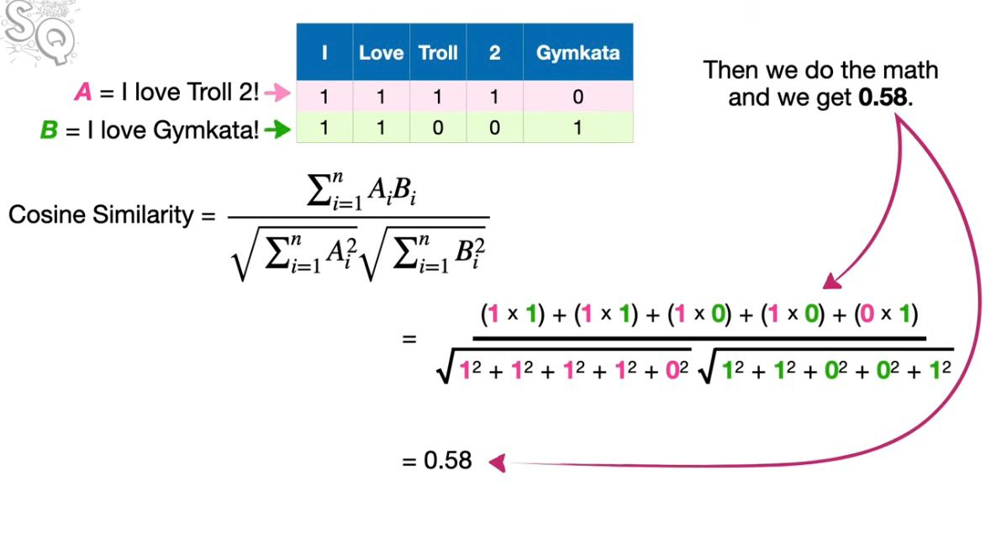

Slide 16
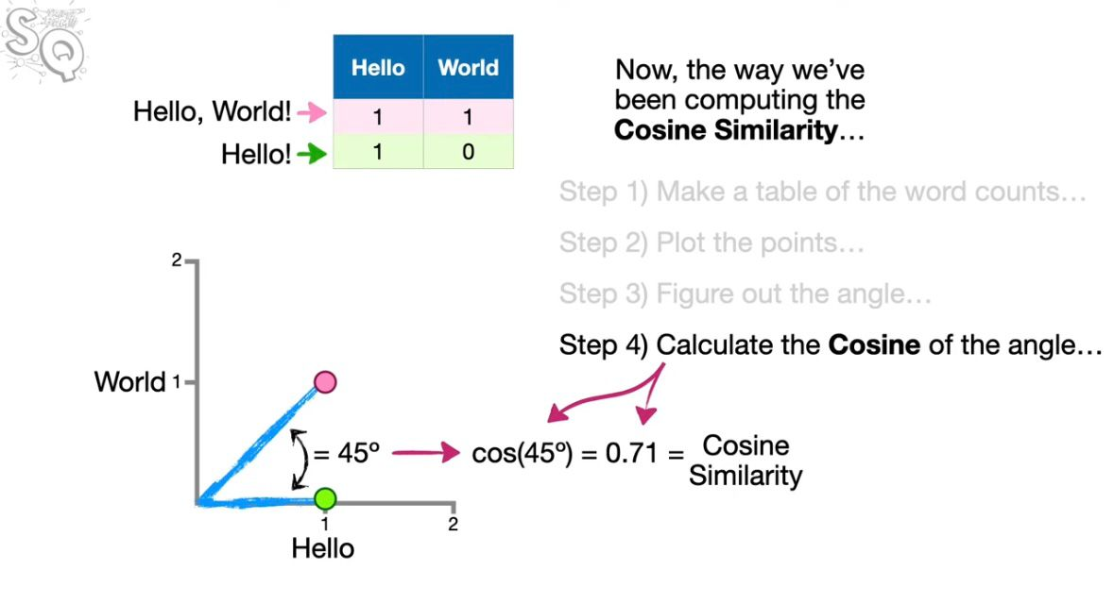
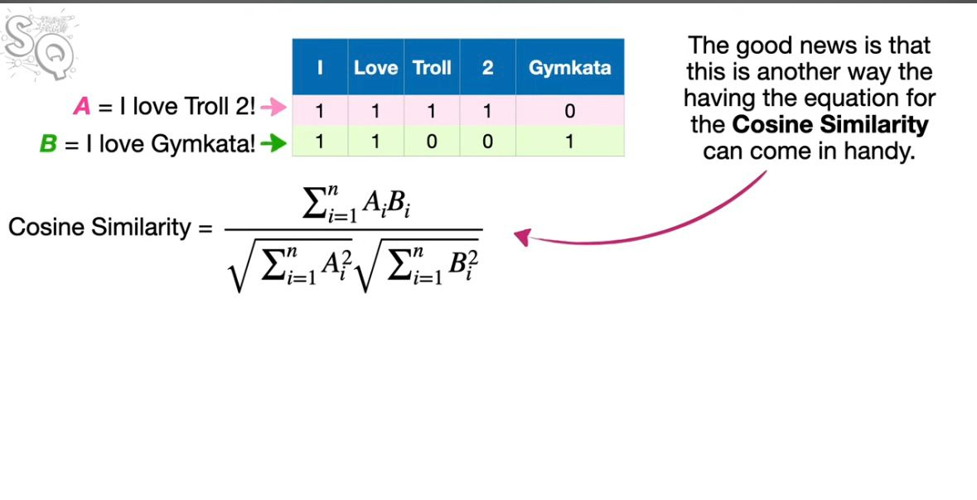

Slide 17
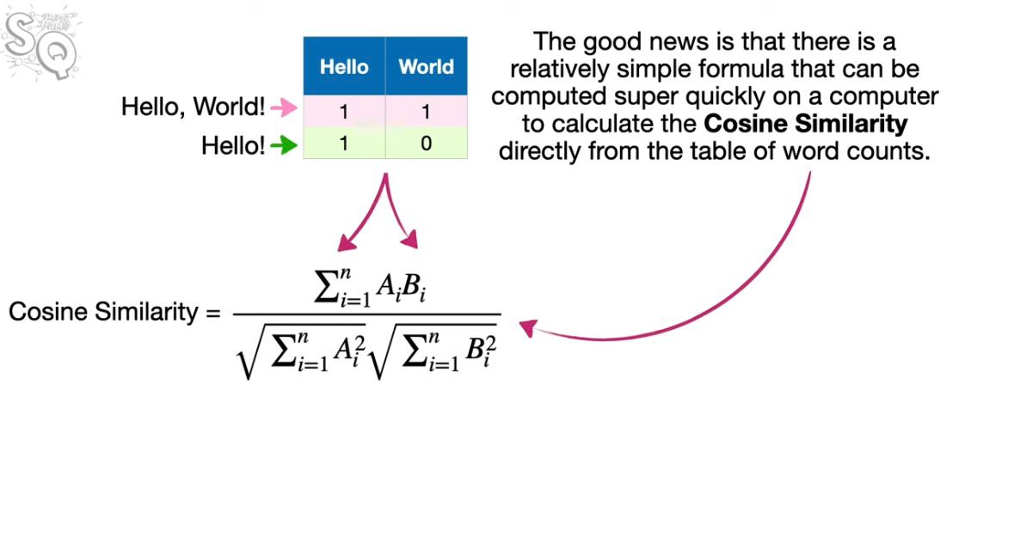
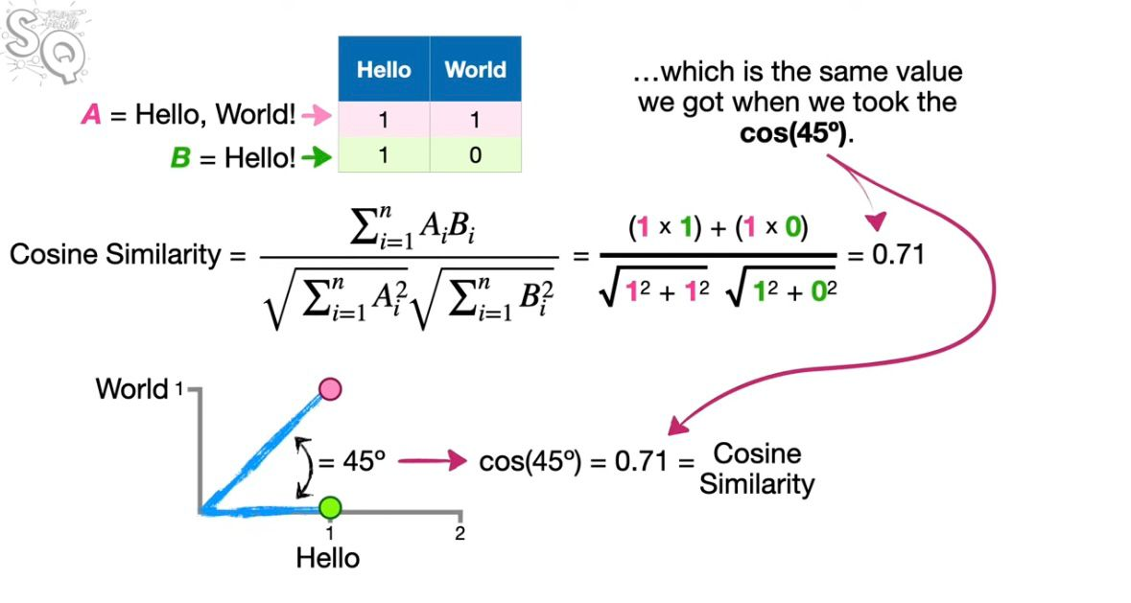

Slide 18
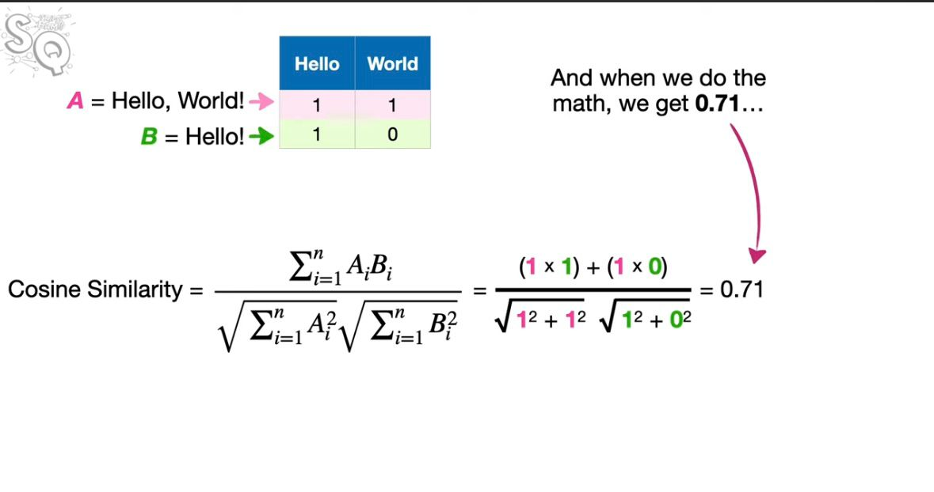

Slide 20
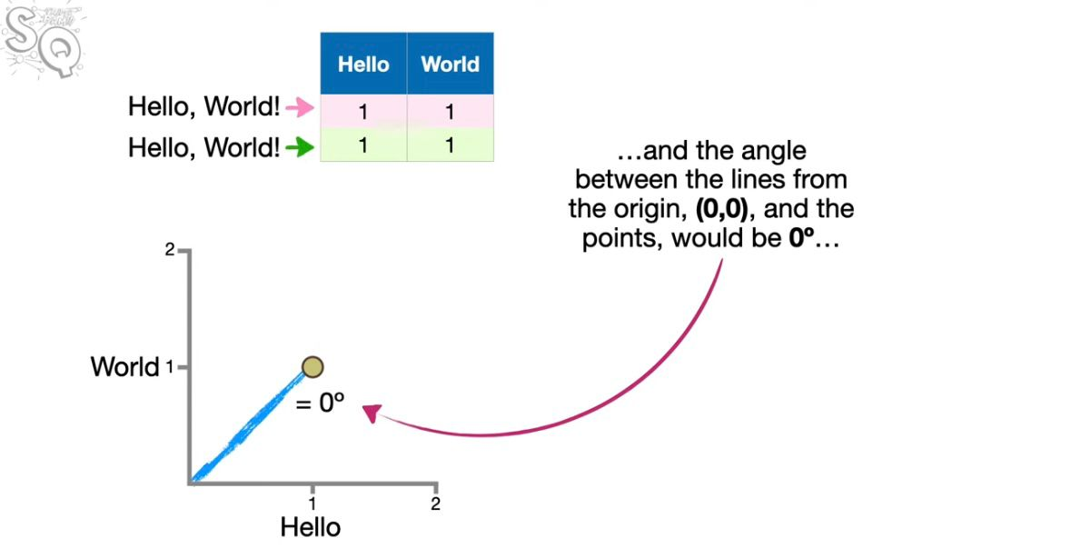

Slide 21
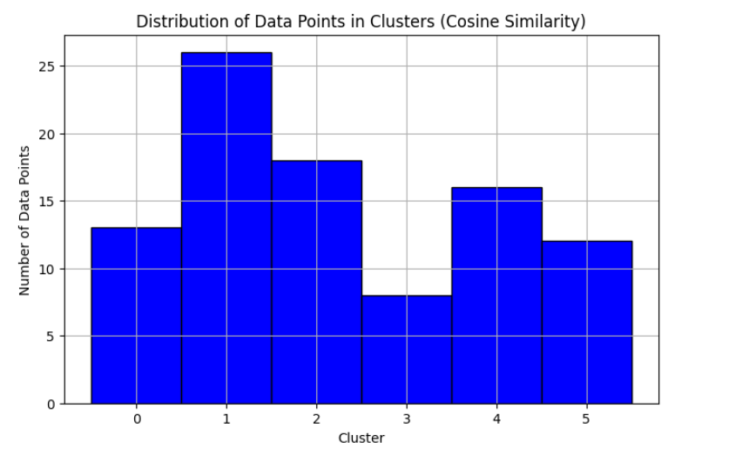
Data Point Distribution of the Clusters

Slide 22
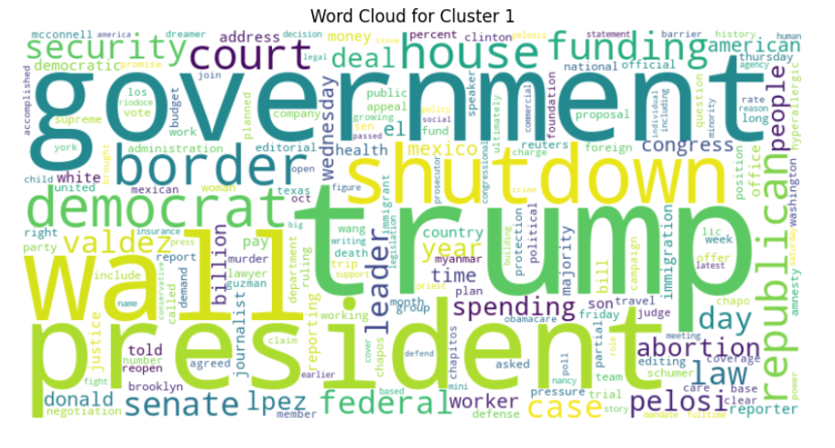
Word Cloud

Slide 23
Silhouette Score
Reasons for low silhouette score:
Dataset Quality and the content
Number of features(Comp Complexity, Overfitting)
Cluster initialization

Slide 24
Solution
Recommended topics to target are politics related

